Slide 1

Dive into Deep Learning
Chapter 2:
Preliminaries Calculus

Slide 2
Contents
Data Manipulation
Reading the Dataset
Handling Missing Data
Linear Algebra
Scalars
Automatic Differentiation
Probability
Calculus
Documentation
Data Preprocessing
Conversion to the Tensor Format
Matrices
Tensors
Getting Started
Operations
Broadcasting Mechanism
Indexing and Slicing
Saving Memory
Conversion to Other Python Objects
Vectors
Basic Properties of Tensor Arithmetic
Derivatives and Differentiation
Partial Derivatives
Gradients
Chain Rule
A Simple Example
Backward for Non-Scalar Variables
Detaching Computation
Computing the Gradient of Python Control Flow
Basic Probability Theory
Dealing with Multiple Random Variables
Expectation and Variance
Finding All the Functions and Classes in a Module
Finding the Usage of Specific Functions and Classes
+6 sections
Linear Algebra cont.
Reduction
Dot Products
Matrix-Vector Products
Matrix-Matrix Multiplication
Norms
More on Linear Algebra

Slide 3
Contents
CH2
Data Manipulation
Data Preprocessing
Linear Algebra
Linear Algebra cont.
Calculus
Automatic Differentiation
Probability
Documentation
Getting Started
Reading the Dataset
Scalars
Reduction
Derivatives and Differentiation
A Simple Example
Basic Probability Theory
Finding All the Functions and Classes in a Module
Operations
Handling Missing Data
Vectors
Dot Products
Partial Derivatives
Backward for Non-Scalar Variables
Dealing with Multiple Random Variables
Finding the Usage of Specific Functions and Classes
Broadcasting Mechanism
Conversion to the Tensor Format
Matrices
Matrix-Vector Products
Gradients
Detaching Computation
Expectation and Variance
Indexing and Slicing
Tensors
Matrix-Matrix Multiplication
Chain Rule
Computing the Gradient of Python Control Flow
Saving Memory
Basic Properties of Tensor Arithmetic
Norms
Conversion to Other Python Objects
+6 sections
More on Linear Algebra

Slide 4
Calculus
Among the most critical applications of differential calculus is the optimization problems.
Optimization problems consider how to do something the best.
In deep learning, we train models, updating them successively so that they get better and better as they see more and more data.
Model
Training Model
Testing Model
Data

Slide 5
Calculus
Getting better means minimizing a loss function.
Loss function is a score that answers the question “how bad is our model?”.
Ultimately, we care about producing a model that performs well on never-seen data.
We can decompose the task of fitting models into two key concerns:
Optimization: the process of fitting our models to observed data;
Generalization: the mathematical principles and practitioners’ wisdom that guide as to how to produce models whose validity extends beyond the exact set of data examples used to train them.
Optimization
Generalization
Fit Model

Slide 6
Contents
CH2
Data Manipulation
Data Preprocessing
Linear Algebra
Linear Algebra cont.
Calculus
Automatic Differentiation
Probability
Documentation
Getting Started
Reading the Dataset
Scalars
Reduction
Derivatives and Differentiation
A Simple Example
Basic Probability Theory
Finding All the Functions and Classes in a Module
Operations
Handling Missing Data
Vectors
Dot Products
Partial Derivatives
Backward for Non-Scalar Variables
Dealing with Multiple Random Variables
Finding the Usage of Specific Functions and Classes
Broadcasting Mechanism
Conversion to the Tensor Format
Matrices
Matrix-Vector Products
Gradients
Detaching Computation
Expectation and Variance
Indexing and Slicing
Tensors
Matrix-Matrix Multiplication
Chain Rule
Computing the Gradient of Python Control Flow
Saving Memory
Basic Properties of Tensor Arithmetic
Norms
Conversion to Other Python Objects
+6 sections
More on Linear Algebra

Slide 7
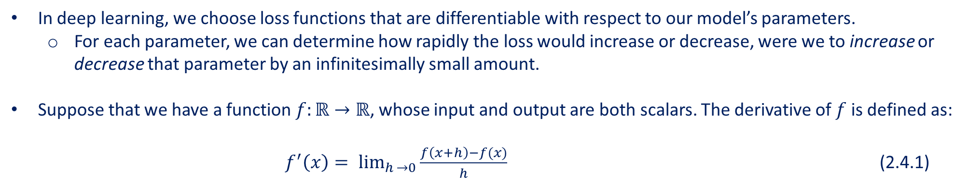
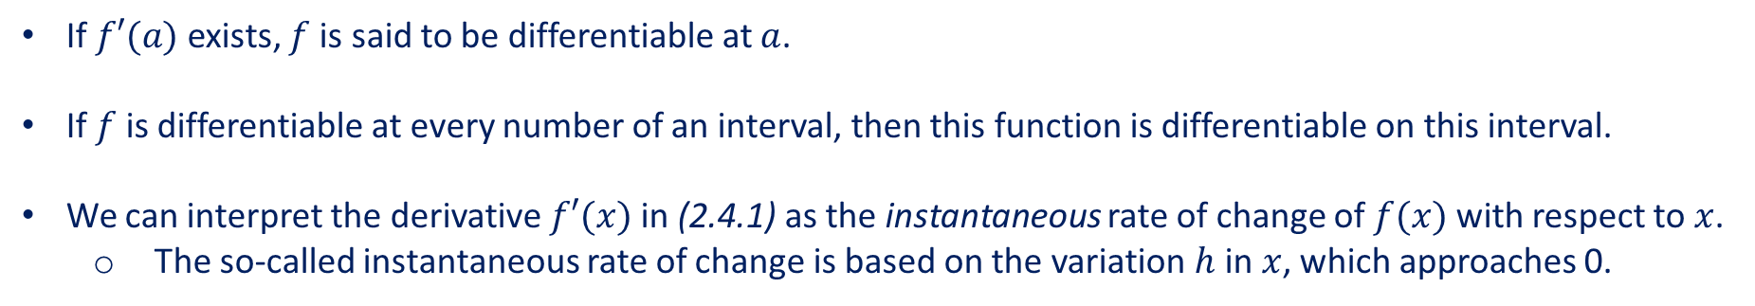
Derivatives and Differentiation
In deep learning, we choose loss functions that are differentiable with respect to our model’s parameters.
For each parameter, we can determine how rapidly the loss would increase or decrease, were we to increase or decrease that parameter by an infinitesimally small amount.
Suppose that we have a function $f:ℝ→ℝ$, whose input and output are both scalars. The derivative of $f$ is defined as:
$f^{′}\left(x\right)= \lim_{h →0}{\frac{f\left(x+h\right)−f(x)}{h}}$ (2.4.1)
If $f′(a)$ exists, $f$ is said to be differentiable at $a$.
If $f$ is differentiable at every number of an interval, then this function is differentiable on this interval.
We can interpret the derivative $f′(x)$ in (2.4.1) as the instantaneous rate of change of $f(x)$ with respect to $x$.
The so-called instantaneous rate of change is based on the variation $h$ in $x$, which approaches 0.

Slide 8

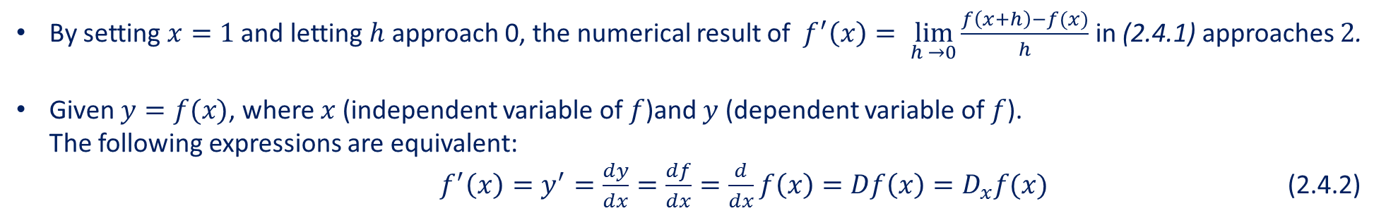
Derivatives and Differentiation
Define $u=f(x)=3x^{2}−4x$.
%matplotlib inline
from d2l import mxnet as d2l
from IPython import display
from mxnet import np, npx
npx.set_np()
def f(x):
return 3 * x ** 2 - 4 * x
By setting $x=1$ and letting $h$ approach 0, the numerical result of $f^{′}\left(x\right)= \lim_{h →0}{\frac{f\left(x+h\right)−f(x)}{h}}$in (2.4.1) approaches $2$.
Given $y=f(x)$, where $x$ (independent variable of $f$)and $y$ (dependent variable of $f$). The following expressions are equivalent:
$f^{′}\left(x\right)=y^{′}=\frac{dy}{dx}=\frac{df}{dx}=\frac{d}{dx}f\left(x\right)=Df\left(x\right)=D_{x}f(x)$ (2.4.2)

Slide 9
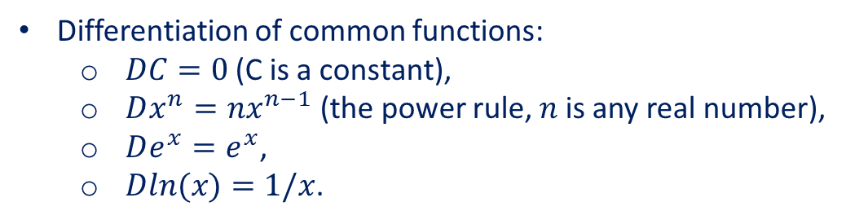
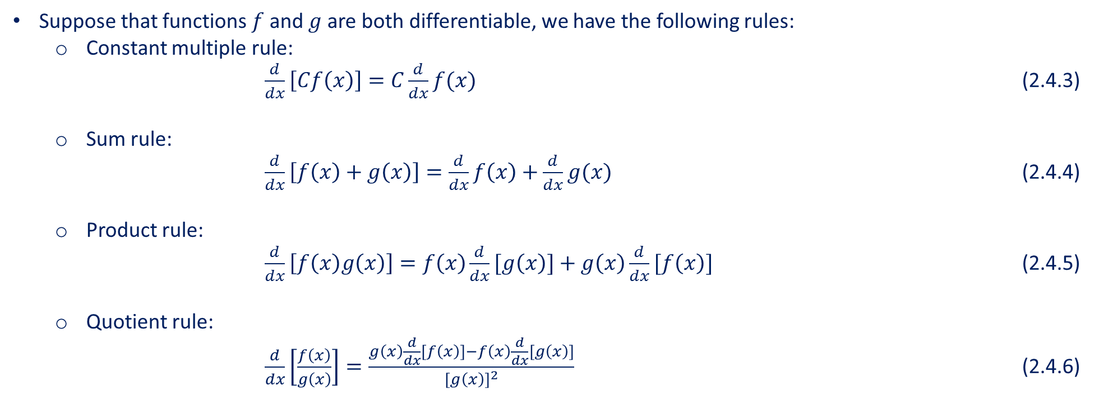
Derivatives and Differentiation
Differentiation of common functions:
$DC=0$ (C is a constant),
$Dx^{n}=nx^{n−1}$ (the power rule, $n$ is any real number),
$De^{x}=e^{x}$,
$Dln(x)=1/x$.
Suppose that functions $f$ and $g$ are both differentiable, we have the following rules:
Constant multiple rule:
$\frac{d}{dx}\left[Cf\left(x\right)\right]=C\frac{d}{dx}f(x)$ (2.4.3)
Sum rule:
$\frac{d}{dx}\left[f\left(x\right)+g\left(x\right)\right]=\frac{d}{dx}f\left(x\right)+\frac{d}{dx}g(x)$ (2.4.4)
Product rule:
$\frac{d}{dx}\left[f\left(x\right)g\left(x\right)\right]=f\left(x\right)\frac{d}{dx}[g\left(x\right)]+g\left(x\right)\frac{d}{dx}[f\left(x\right)]$ (2.4.5)
Quotient rule:
$\frac{d}{dx}\left[\frac{f\left(x\right)}{g\left(x\right)}\right]=\frac{g\left(x\right)\frac{d}{dx}\left[f\left(x\right)\right]−f\left(x\right)\frac{d}{dx}[g\left(x\right)]}{{\left[g\left(x\right)\right]}^{2}}$ (2.4.6)

Slide 10
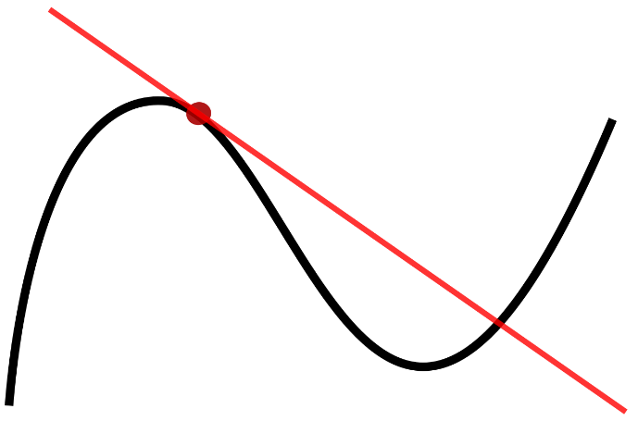
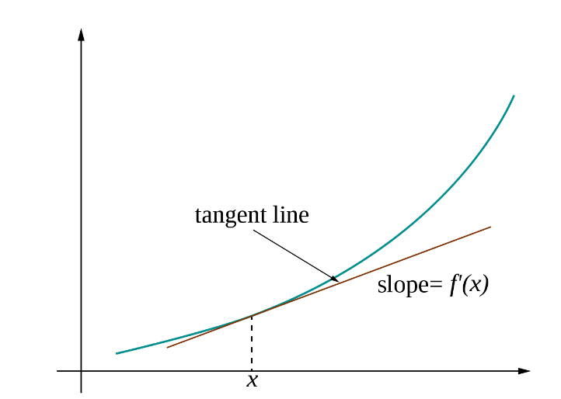
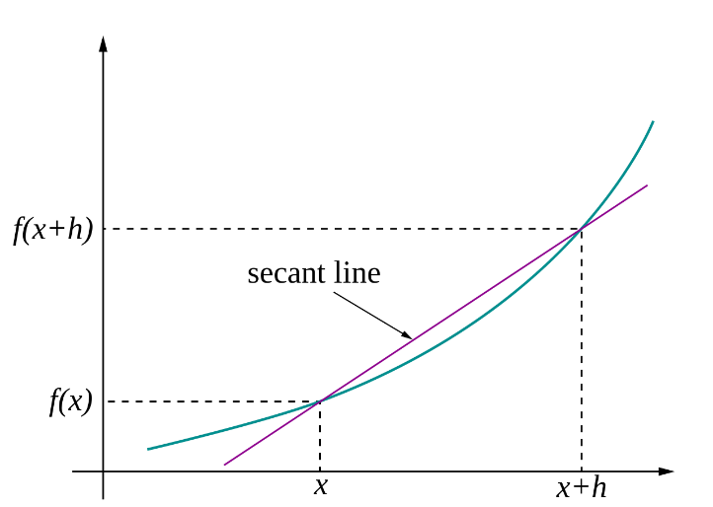
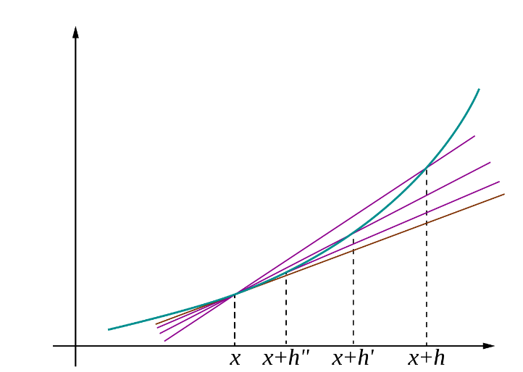
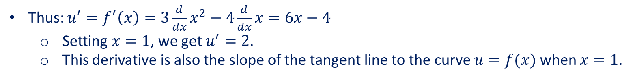
Derivatives and Differentiation
Thus: $u^{′}=f^{′}\left(x\right)=3\frac{d}{dx}x^{2}−4\frac{d}{dx}x=6x−4$
Setting $x=1$, we get $u^{′}=2$.
This derivative is also the slope of the tangent line to the curve $u=f(x)$ when $x=1$.
The graph of a function, drawn in black, and a tangent line to that function, drawn in red. The slope of the tangent line is equal to the derivative of the function at the marked point.
The tangent line at (x, f(x))
The secant to curve y= f(x) determined by points (x, f(x)) and (x + h, f(x + h))
The tangent line as limit of secants

Slide 11
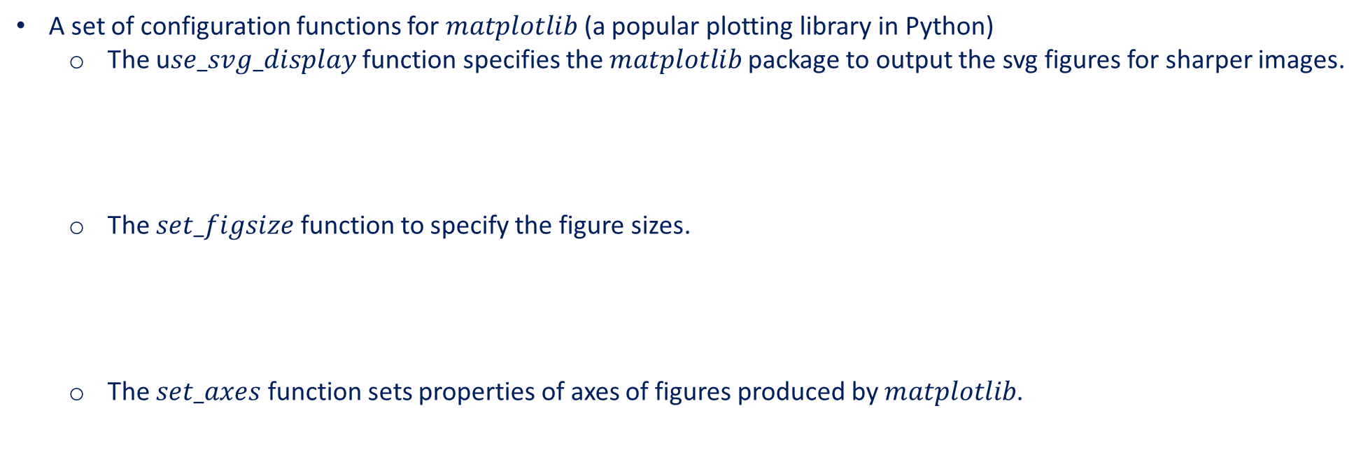
Derivatives and Differentiation
A set of configuration functions for $matplotlib$ (a popular plotting library in Python)
The u$se_svg_display$ function specifies the $matplotlib$ package to output the svg figures for sharper images.
The $set_figsize$ function to specify the figure sizes.
The $set_axes$ function sets properties of axes of figures produced by $matplotlib$.
def use_svg_display(): #@save
"""Use the svg format to display a plot in Jupyter."""
display.set_matplotlib_formats('svg')
def set_figsize(figsize=(3.5, 2.5)): #@save
"""Set the figure size for matplotlib."""
use_svg_display()
d2l.plt.rcParams['figure.figsize'] = figsize
#@save
def set_axes(axes, xlabel, ylabel, xlim, ylim, xscale, yscale, legend):
"""Set the axes for matplotlib."""
axes.set_xlabel(xlabel)
axes.set_ylabel(ylabel)
axes.set_xscale(xscale)
axes.set_yscale(yscale)
axes.set_xlim(xlim)
axes.set_ylim(ylim)
if legend:
axes.legend(legend)
axes.grid()

Slide 12
Derivatives and Differentiation
We define the plot function to plot multiple curves succinctly.
#@save
def plot(X, Y=None, xlabel=None, ylabel=None, legend=None, xlim=None,
ylim=None, xscale='linear', yscale='linear',
fmts=('-', 'm--', 'g-.', 'r:'), figsize=(3.5, 2.5), axes=None):
"""Plot data points."""
if legend is None:
legend = []
set_figsize(figsize)
axes = axes if axes else d2l.plt.gca()
# Return True if `X` (tensor or list) has 1 axis
def has_one_axis(X):
return (hasattr(X, "ndim") and X.ndim == 1 or isinstance(X, list)
and not hasattr(X[0], "__len__"))
if has_one_axis(X):
X = [X]
if Y is None:
X, Y = [[]] * len(X), X
elif has_one_axis(Y):
Y = [Y]
if len(X) != len(Y):
X = X * len(Y)
axes.cla()
for x, y, fmt in zip(X, Y, fmts):
if len(x):
axes.plot(x, y, fmt)
else:
axes.plot(y, fmt)
set_axes(axes, xlabel, ylabel, xlim, ylim, xscale, yscale, legend)

Slide 13
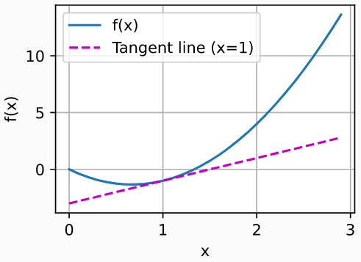
Derivatives and Differentiation
We can plot the function $u=f(x)$ and its tangent line $y=2x−3$ at $x=1$
The coefficient $2$ is the slope of the tangent line.
x = np.arange(0,3,0.1)
plot(x, [f(x), 2*x-3],'x','f(x)', legend=['f(x)', 'Tangent line (x=1)'])

Slide 14
Contents
CH2
Data Manipulation
Data Preprocessing
Linear Algebra
Linear Algebra cont.
Calculus
Automatic Differentiation
Probability
Documentation
Getting Started
Reading the Dataset
Scalars
Reduction
Derivatives and Differentiation
A Simple Example
Basic Probability Theory
Finding All the Functions and Classes in a Module
Operations
Handling Missing Data
Vectors
Dot Products
Partial Derivatives
Backward for Non-Scalar Variables
Dealing with Multiple Random Variables
Finding the Usage of Specific Functions and Classes
Broadcasting Mechanism
Conversion to the Tensor Format
Matrices
Matrix-Vector Products
Gradients
Detaching Computation
Expectation and Variance
Indexing and Slicing
Tensors
Matrix-Matrix Multiplication
Chain Rule
Computing the Gradient of Python Control Flow
Saving Memory
Basic Properties of Tensor Arithmetic
Norms
Conversion to Other Python Objects
+6 sections
More on Linear Algebra

Slide 15
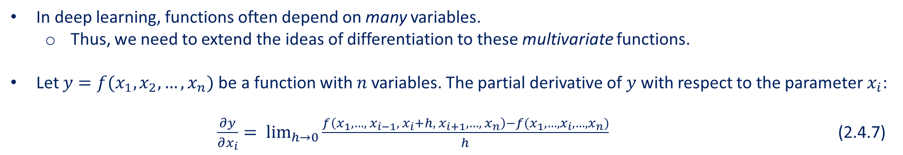
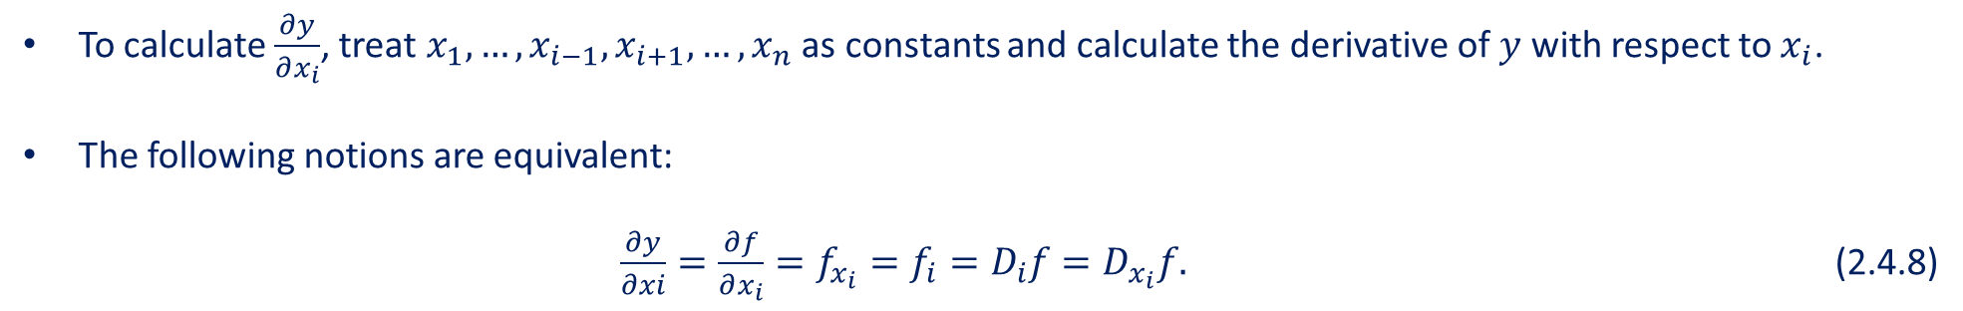
Partial Derivatives
In deep learning, functions often depend on many variables.
Thus, we need to extend the ideas of differentiation to these multivariate functions.
Let $y=f(x_{1},x_{2},…,x_{n})$ be a function with $n$ variables. The partial derivative of $y$ with respect to the parameter $x_{i}$:
$\frac{∂y}{∂x_{i}}= \lim_{h→0}{\frac{f\left(x_{1},…,{ x}_{i−1}, { x}_{i}+h, x_{i+1},…,{ x}_{n}\right)−f(x_{1},…,x_{i},…,x_{n})}{h}}$ (2.4.7)
To calculate $\frac{∂y}{∂x_{i}}$, treat $x_{1},…,x_{i−1},x_{i+1},…,x_{n}$ as constants and calculate the derivative of $y$ with respect to $x_{i}$.
The following notions are equivalent:
$\frac{∂y}{∂xi}=\frac{∂f}{∂x_{i}}=f_{x_{i}}=f_{i}=D_{i}f=D_{x_{i}}f.$ (2.4.8)

Slide 16
Contents
CH2
Data Manipulation
Data Preprocessing
Linear Algebra
Linear Algebra cont.
Calculus
Automatic Differentiation
Probability
Documentation
Getting Started
Reading the Dataset
Scalars
Reduction
Derivatives and Differentiation
A Simple Example
Basic Probability Theory
Finding All the Functions and Classes in a Module
Operations
Handling Missing Data
Vectors
Dot Products
Partial Derivatives
Backward for Non-Scalar Variables
Dealing with Multiple Random Variables
Finding the Usage of Specific Functions and Classes
Broadcasting Mechanism
Conversion to the Tensor Format
Matrices
Matrix-Vector Products
Gradients
Detaching Computation
Expectation and Variance
Indexing and Slicing
Tensors
Matrix-Matrix Multiplication
Chain Rule
Computing the Gradient of Python Control Flow
Saving Memory
Basic Properties of Tensor Arithmetic
Norms
Conversion to Other Python Objects
+6 sections
More on Linear Algebra

Slide 17
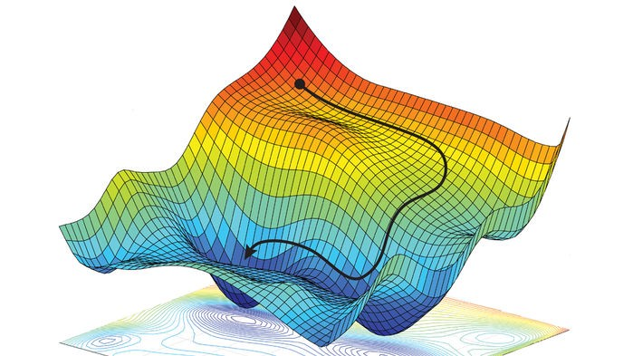
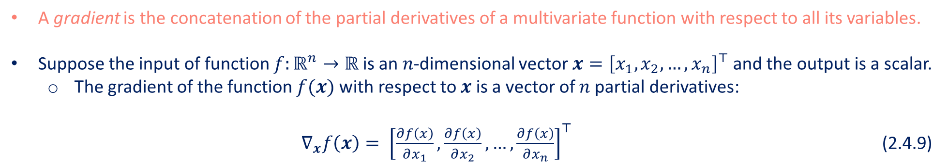
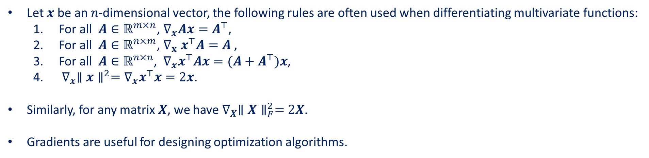
Gradients
A gradient is the concatenation of the partial derivatives of a multivariate function with respect to all its variables.
Suppose the input of function $f:ℝ^{n}→ℝ$ is an $n$-dimensional vector $x={\left[x_{1},x_{2},…,x_{n}\right]}^{⊤}$ and the output is a scalar.
The gradient of the function $f(x)$ with respect to $x$ is a vector of $n$ partial derivatives:
$∇_{x}f\left(x\right)= {\left[\frac{∂f\left(x\right)}{∂x_{1}},\frac{∂f\left(x\right)}{∂x_{2}}, …,\frac{∂f\left(x\right)}{∂x_{n}}\right]}^{⊤}$ (2.4.9)
Let $x$ be an $n$-dimensional vector, the following rules are often used when differentiating multivariate functions:
For all $A∈ℝ^{m×n}$, $∇_{x}Ax=A^{⊤}$,
For all $A∈ℝ^{n×m}$, $∇_{x}{ x}^{⊤}A=A$ ,
For all $A∈ℝ^{n×n}$, $∇_{x}x^{⊤}Ax=(A+A^{⊤})x$,
$∇_{x}∥x∥^{2}=∇_{x}x^{⊤}x=2x$.
Similarly, for any matrix $X$, we have $∇_{X}∥X∥_{F}^{2}=2X$.
Gradients are useful for designing optimization algorithms.
Source: https://reconsider.news/2018/05/09/ai-researchers-allege- machine-learning-alchemy/

Slide 18
Contents
CH2
Data Manipulation
Data Preprocessing
Linear Algebra
Linear Algebra cont.
Calculus
Automatic Differentiation
Probability
Documentation
Getting Started
Reading the Dataset
Scalars
Reduction
Derivatives and Differentiation
A Simple Example
Basic Probability Theory
Finding All the Functions and Classes in a Module
Operations
Handling Missing Data
Vectors
Dot Products
Partial Derivatives
Backward for Non-Scalar Variables
Dealing with Multiple Random Variables
Finding the Usage of Specific Functions and Classes
Broadcasting Mechanism
Conversion to the Tensor Format
Matrices
Matrix-Vector Products
Gradients
Detaching Computation
Expectation and Variance
Indexing and Slicing
Tensors
Matrix-Matrix Multiplication
Chain Rule
Computing the Gradient of Python Control Flow
Saving Memory
Basic Properties of Tensor Arithmetic
Norms
Conversion to Other Python Objects
+6 sections
More on Linear Algebra

Slide 19
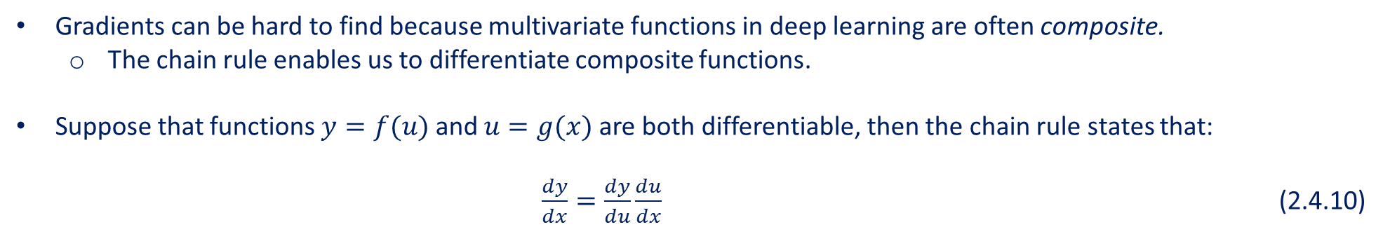
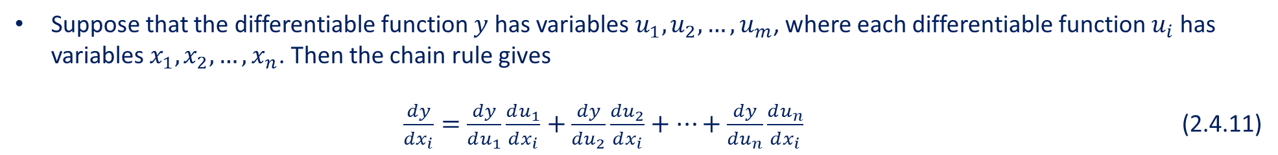
Chain Rule
Gradients can be hard to find because multivariate functions in deep learning are often composite.
The chain rule enables us to differentiate composite functions.
Suppose that functions $y=f(u)$ and $u=g(x)$ are both differentiable, then the chain rule states that:
$\frac{dy}{dx}=\frac{dy}{du}\frac{du}{dx}$ (2.4.10)
Suppose that the differentiable function $y$ has variables $u_{1},u_{2},…,u_{m}$, where each differentiable function $u_{i}$ has variables $x_{1},x_{2},…,x_{n}$. Then the chain rule gives
$\frac{dy}{dx_{i}}=\frac{dy}{du_{1}}\frac{du_{1}}{dx_{i}}+\frac{dy}{du_{2}}\frac{du_{2}}{dx_{i}}+…+\frac{dy}{du_{n}}\frac{du_{n}}{dx_{i}}$ (2.4.11)

Slide 20
Summary
Differential calculus and integral calculus are two branches of calculus, where the former can be applied to the ubiquitous optimization problems in deep learning.
A derivative can be interpreted as the instantaneous rate of change of a function with respect to its variable. It is also the slope of the tangent line to the curve of the function.
A gradient is a vector whose components are the partial derivatives of a multivariate function with respect to all its variables.
The chain rule enables us to differentiate composite functions.

